Slide 1
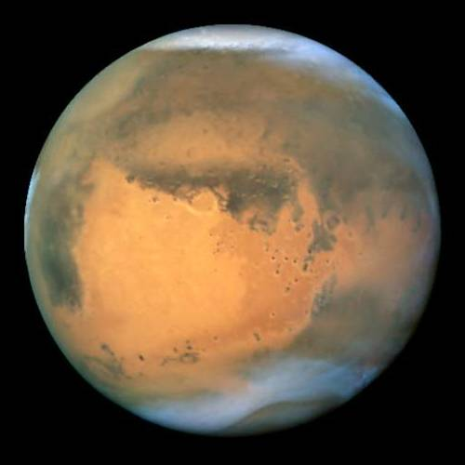
OBSERVING MARS 2012
Mars (god of war)
Nirgal (star of death)
Angakara (burning coal)
Huoxing (fire star)
A DROP OF CURDLED BLOOD IN THE NIGHT SKY
Notes:
Purpose -- to present a brief introduction to Mars, why to me it is the ultimate object to observe
Next month I will focus on how to get the most out of observing Mars
Please keep in mind during this talk that I am not an expert on Mars -- only someone who has an interest in observing the planet through a small telescope -- to enjoy observing an object you must first know about that object
Also I would like to thank NASA and all of its associated contractors for supplying most of the images for this presentation

Slide 2
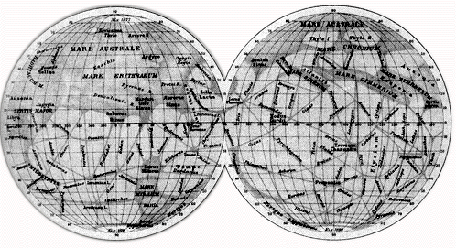
“We may hope that, because the world of Mars is older than ours, humankind there will be more advance and wiser” – Flammarion
“Yet across an immense ethereal gulf, minds that are to our minds as ours are to the beasts in the jungle, intellects vast and cool and unsympathetic regarded this earth with envious eyes and slowly and surely drew their plans against us” – War of the Worlds
Notes:
Man’s view of Mars in the past has been based more on imagination than science. Man’s view of Mars has changed overtime
When this map was made the bright areas were thought to be continents and dark areas seas (named as bodies of water found around the Mediterranean world)
When I was 5 yrs and went to bed with my 1st Mars book under my pillow – Mars was home to an advanced race of intelligent beings living in crystalline cities surrounded with lust seasonal vegetation and thousands of miles of canals brimming with water.
By the time I started seriously observing Mars, Mars had changed in my mind to a place where it always had been a cold, dry, barren desert, a thin atmosphere without protection from ultraviolet rays and little hope for life.
But once again my views of Mars have been shattered in the past couple of years mainly buy the data gathered by the Mars Global Surveyor

Slide 3
The GOOD, the BAD, the UGLY
The Good:
You can see clouds, dark markings, the polar cap or hood plus much more surface detail than on any other planet
Mars is placed high in the sky much more so than in most apparitions
You can observe Mars when the moon is bright
The Bad:
Mars only gets 13.9” in size at maximum in the apparition of 2012
In the dead of winter – clear skies but often very unstable
Mars is going to be small, very bright, with its surface markings subtle. At first all you are likely to see is a yellow-orange ball with bright edges and an ill -defined dusky brown-smudge or two if lucky. Not like enhanced highly processed photos or even detailed drawings.
The Ugly:
Viewing Mars will be like trying to see details within a medium-sized lunar crater at full moon --while the crater is covered in a thick Los Angeles like-smog

Slide 4
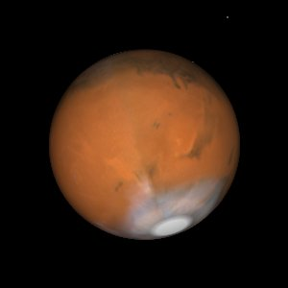
Mars 2012
Mars will reach opposition on March 3rd and will be closest to Earth on March 5th. At that time it will reach 13.9 arcseconds in diameter at a distance 62,622,315 miles.
It is not until July 2018 that we get a close approach where it will peak at 24.3”.
From now through March the NP Cap will be shrinking (Martian northern spring season) while the SP Hood will be expanding.
A simulated view of the appearance of Mars during opposition at 2004 UT on March 03, 2012 (78.1° Ls, CM 189.8°)

Slide 5
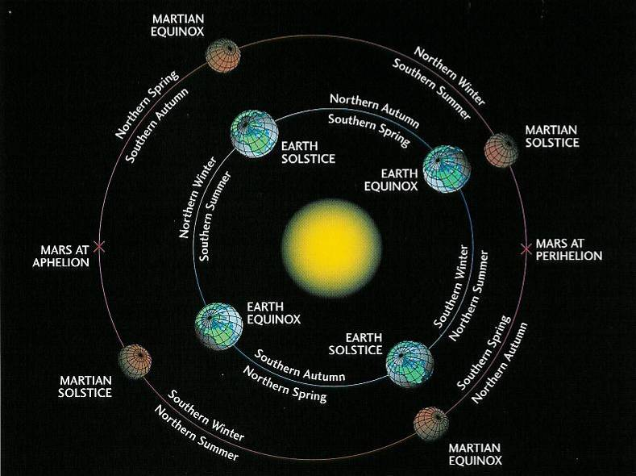
20% closer to the sun during perihelion (SP cap faces the sun) than at aphelion (NP cap faces the sun)
Southern Summers are 52 days shorter but 64 F warmer (45% more sun) than Summers in the north
From Earth 50% brighter when closest (wheat colored) than furthest (blood red)
Notes:
Compared to Earth, Mars has a very elliptical Orbit. While Earth’s seasons are about equal – those on Mars are not.

Slide 6
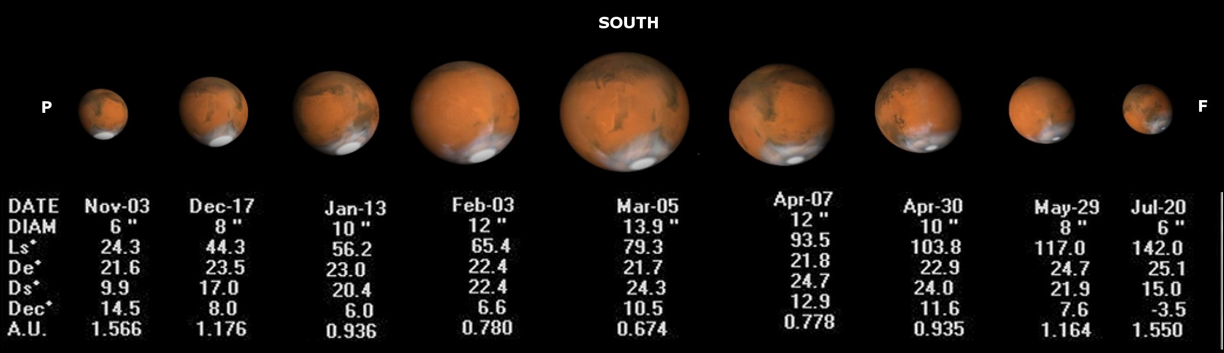

Slide 7
“Oft expectation fails, and most oft / there / Where most it promises.” Shakespeare -- All’s Well That Ends Well, 2.1.145
“History has shown that [Mars] has revealed itself only to those who care. We do not expect first-time observers to come away from the eyepiece with a complete understanding of what he or she has seen. Nor do we expect novice observers to see much.” W. Sheehan & S.J. O’Meara (The Lure of the Red Planet)
Notes:
My goal is to make sure that you get the most out of this opposition.

Slide 8
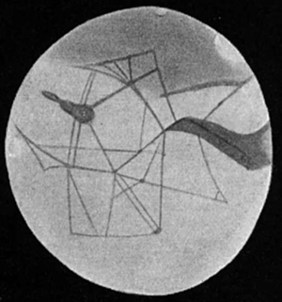
“Nothing is ever seen perfectly, but only by fragments, and under various conditions of obscurity” – John Ruskin
Notes:
Schiaparelli late 19th century – color blind which made color hues invisible but increased contrast – where two areas of slightly different contrast came together he saw a line. Today, I view Mars through the filter of knowing that there are no canals, therefore when I see a faint line I try some filters and tease out the contrast areas. It is likely that my perception of Mars (and thus my drawings) would have looked different if I was observing at the turn of the 20th century.
If you see lines draw them. If your drawing of Mars is covered with lines I would not recommend that you not show them to anyone.

Slide 9
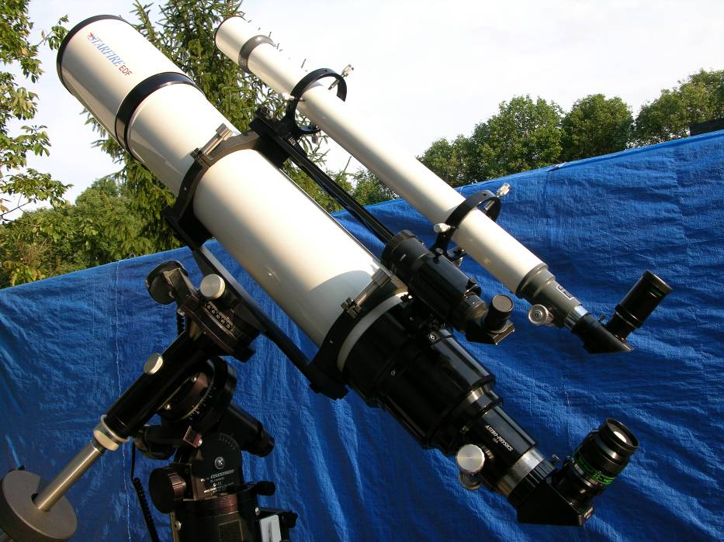
To See Mars at its Best (small bright with subtle markings)
Telescope (quality, size) Your goal is to maximize contrast and resolution
Resolution (Dawes limit) vs. contrast
Dobsonians – collimation is the key
MAK & SCT – watch for tube currents
Trust your telescope – expect to be disappointed in your initial image of Mars
Location of Telescope
High Power (60-75x/inch on 8” or less; on 12” or more 500x) – eyepiece/barlow quality – refractors dump the diagonal if you can
Mount (high quality drive) and Chair
Patience and Practice
Familiarity with the gross surface markings -- know what to look for on Mars
Notes:
On my 18” f4.5 Dobsonian has a mirror to die for. But it has a diffraction-limited field of only 0.08 inches across. For Mars close does not cut it. A laser on its own will not do it – Use a barlowed laser or autocollimator or your buddy with the 4” apo is going to embarrass the hell out of you!
If you sneeze re-collimate, if you forget to sneeze do it anyway. I do not believe in off masking your mirror, you paid good money for it – use it, if too bright use a filter.
It is nice to have a rock solid motor drive that tracks smoothly at 300+x – observing Mars is demanding and it is nice to give your eyes a rest and take a sip of hot chocolate – then return and have Mars still in the center of the eyepiece – being able to sit down to observe and focus on the planet not having to worry about the mount or Mars slipping off the edge will really help – not a necessity but it helps
I like my APO because it eliminates collimation from the equation, gives me a smooth running equatorial mount and can observe sitting

Slide 10
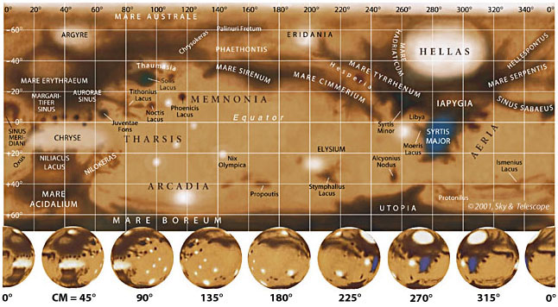
MAP OF MARS AND VISUAL SIDE
Dark Brown/red Areas = mixed dust sizes or exposed rock
Light Red Areas = lots of fine-grained dust
White Areas = clouds, frost, ice, fog

Slide 11
Getting familiar with Mars
1) Syrtis Major¹ 7) Sinus Cimmerium⁵
2) Hellas² 8) Sinus Tryrrhenum⁵
3) Sinus Sabaeus 9) Proponitis Complex
4) Sinus Meridiani³ 10) Solis Lacus⁴
5) Utopia 11) Mare Erythraeum
6) Sinus Sirenum⁵ 12) Mare Acidalium
KEY:
1 = means Mediterranean Sea (old names Hourglass Sea, Blue Scorpion, Frasier Sea)
2 = means Greece (largest impact basin in the Solar System)
3 = Dawes’ Forked Bay (zero longitude)
4 = Eye of Mars (Schiaparelli’s “Land of Wonder”)
5 = Schiaparelli’s “Great Diaphragm”
Notes:
Syrtis (SEAR-tis) Major Sinus Sabaeus (sa-BYE-us) Sinus Meridiani (mair-id-ee-AH-nee)
Sinus Sirenum (Sir-ee-num) Sinus Cimmerium (sim-AIR-ee-um) Sinus Tyrrhenum (tir-reen-um)
Solis Lacus (LAH-kus) Mare Erythraeum (air-ih-thry-um) Elysium (ih-LEE-zee-um)
Schiaparelli (Skya-pa-rel-lee) Argyre (AIR-jir) Antoniadi

Slide 12
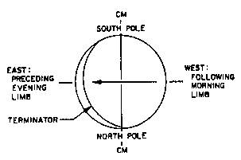
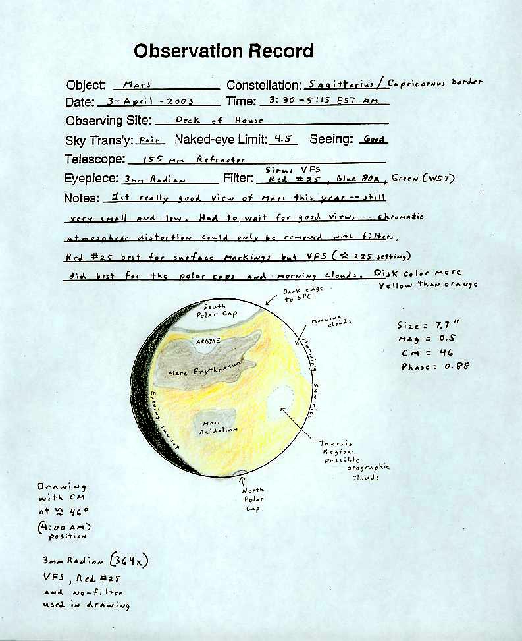
MARS ORIENTATION
Day on Mars = 24 hours, 37 minutes – therefore if you observe the same time night after night the surface features appears to back up (anti-rotational) about 9 degrees every night causing an illusory retrograde rotation of about 36 days.
Polar caps will be offset from the apparent up and down in your eye-piece.

Slide 13
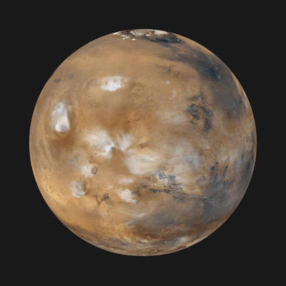
MARTIAN METEOROLOGY
Discrete Atmospheric Clouds
Orographic (Bright in Blue; Faint in Green and Orange) --best seen about two hours before sunset
Localized – e.g. Syrtis Blue Cloud (Best in Blue)
Morning & Evening Clouds (Best in Blue) -- Evening Cloud can be as bright as the polar caps
Limb Brightening
Scattering of Dust (Best in Red)
Scattering of Dry Ice Particles (Best in Blue)
Surface Frosts (Green best -- has sharp edges)
Low level fog or Clouds (Green best --has hazy edges)
Dust Storms (Bright in Red; Faint in Yellow)
Notes:
Brightest clouds occur at the evening limb maybe as bright as polar caps
Orthographic clouds best seen about 2 hours before reaching the evening limb

Slide 14
USE OF COLOR FILTERS (a necessity not a choice; even so – improvements are going to be subtle)
Enhances dark Red (W25) for 6” or more
surface markings Yellow (W15) for 5” or less
Atmospheric clouds, limb Blue (W80A)
hazes, polar caps & hoods
Surface frosts and fog Green (W58)
No filter Color of disk and its markings
Specialized Interference filter(s) General overall views
(Note -- Buy 1-1/4” not 2” since you will be changing filters more than changing eyepieces) -- Filter Wheel recommended – but must be of high quality if you are going to use interference filter(s).

Slide 15
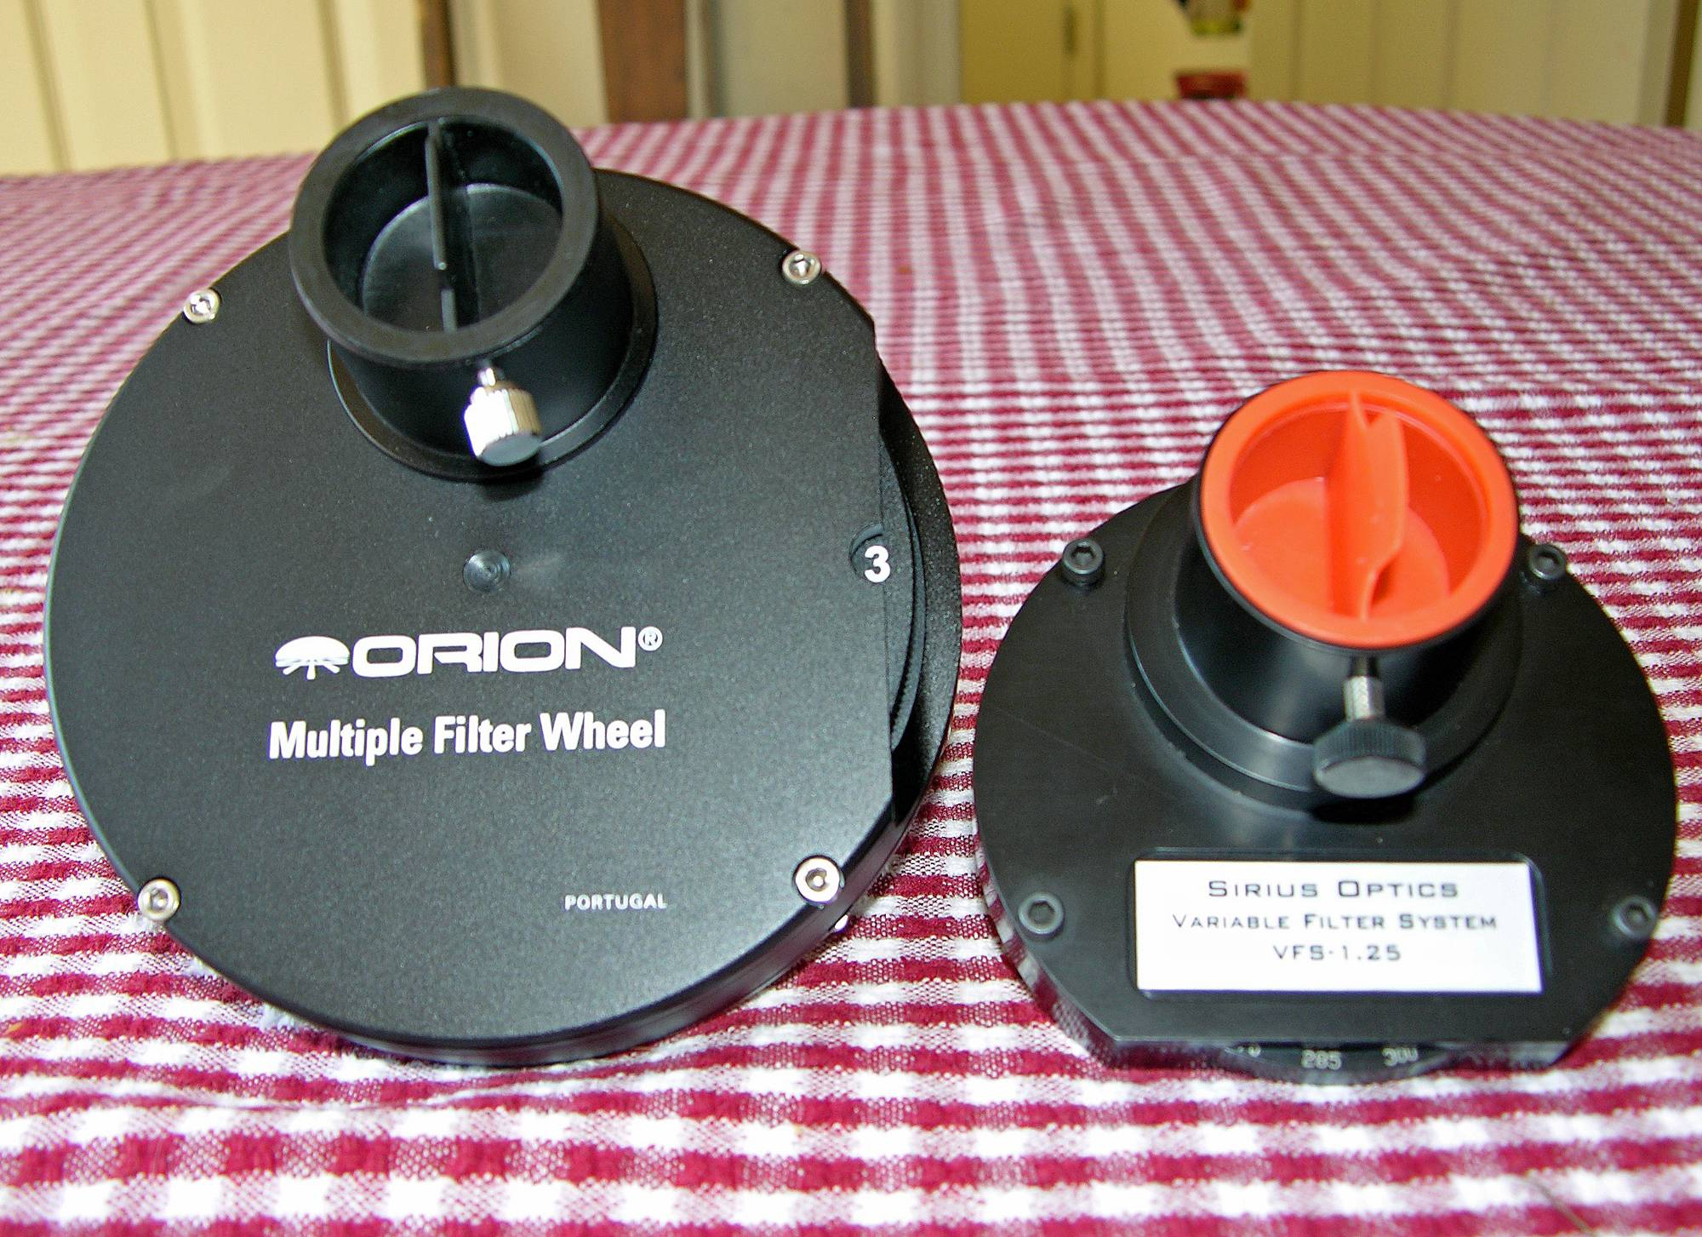
Notes:
Orion Multiple Filter Wheel = Red, Green, Blue, Mars B, and blank

Slide 16
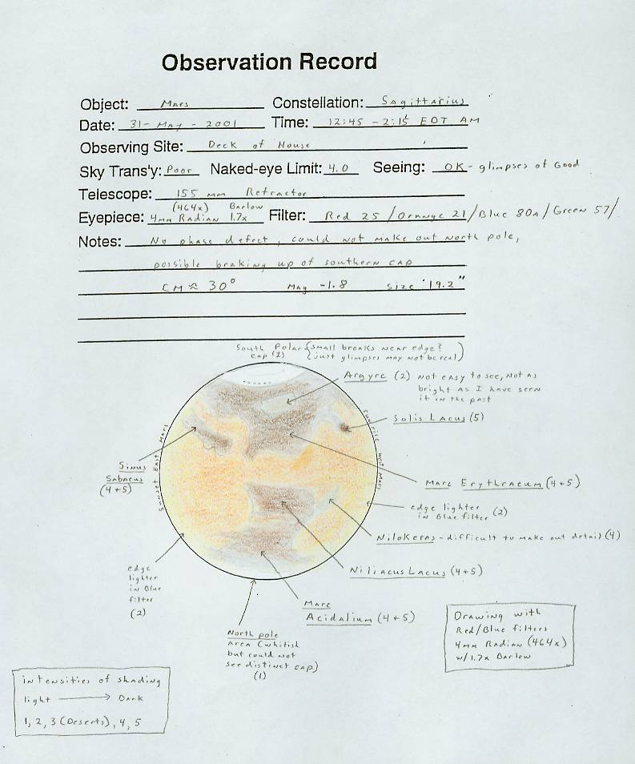
MAKE A DRAWING
Drawing helps you see better – observe a while before starting the drawing
ALPO = 42mm disk
BAA = 50mm disk
I use = 72mm disk
Best = 3mm/arcsecond

Slide 17
MAKE A DRAWING
Drawing helps you see better – observe a while before starting the drawing
ALPO = 42mm disk
BAA = 50mm disk
I use = 72mm disk
Best = 3mm/arcsecond
3) Draw in Phase and PC – take notes
4) Next draw in darker areas (I use a Televue Mars B filter) – take notes

Slide 18
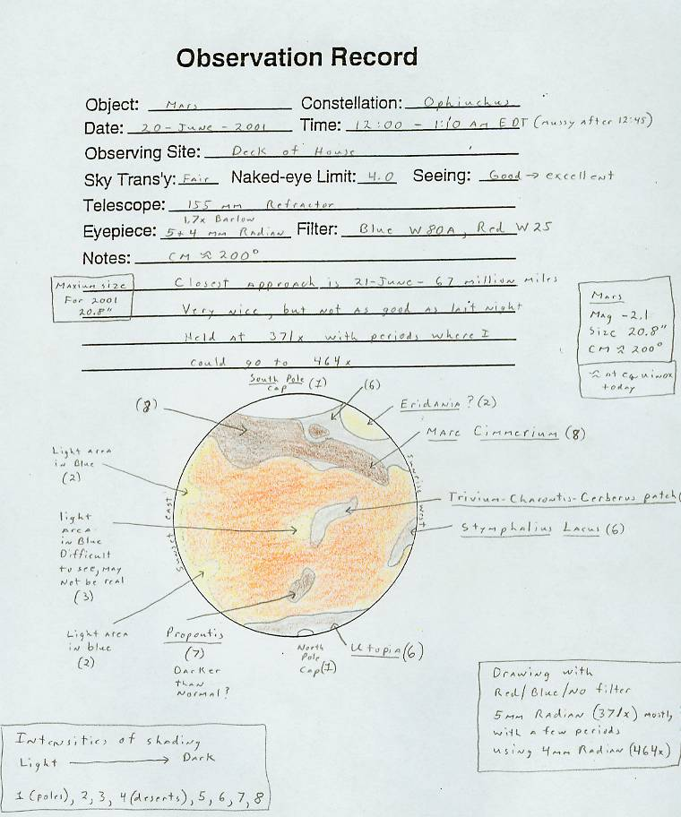
MAKE A DRAWING
Drawing helps you see better – observe a while before starting the drawing
ALPO = 42mm disk
BAA = 50mm disk
I use = 72mm disk
Best = 3mm/arcsecond
Draw in PD and PC – take notes
Next draw in darker areas – take notes (I use a Televue Mars filter B)
Examine with (no filter) the red, green, blue filters make changes to drawing – take notes

Slide 19
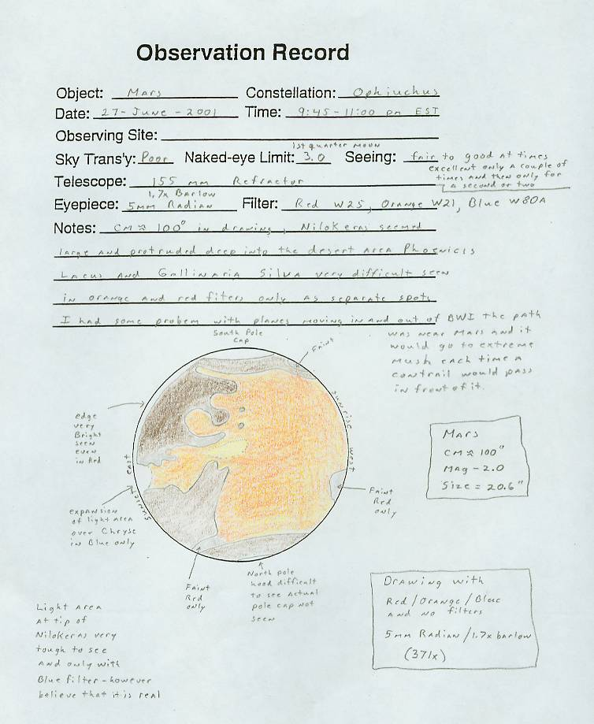
MAKE A DRAWING
Drawing helps you see better – observe a while before starting the drawing
ALPO = 42mm disk
BAA = 50mm disk
I use = 72mm disk
Best = 3mm/arcsecond
Draw in PD and PC – take notes
4) Next draw in darker areas – take
notes (I use a Televue Mars filter B)
5) Examine with (no filter) then red,
green, blue filters make changes to
drawing – take notes
6) Re-draw your observations using color as soon after observing as possible

Slide 20
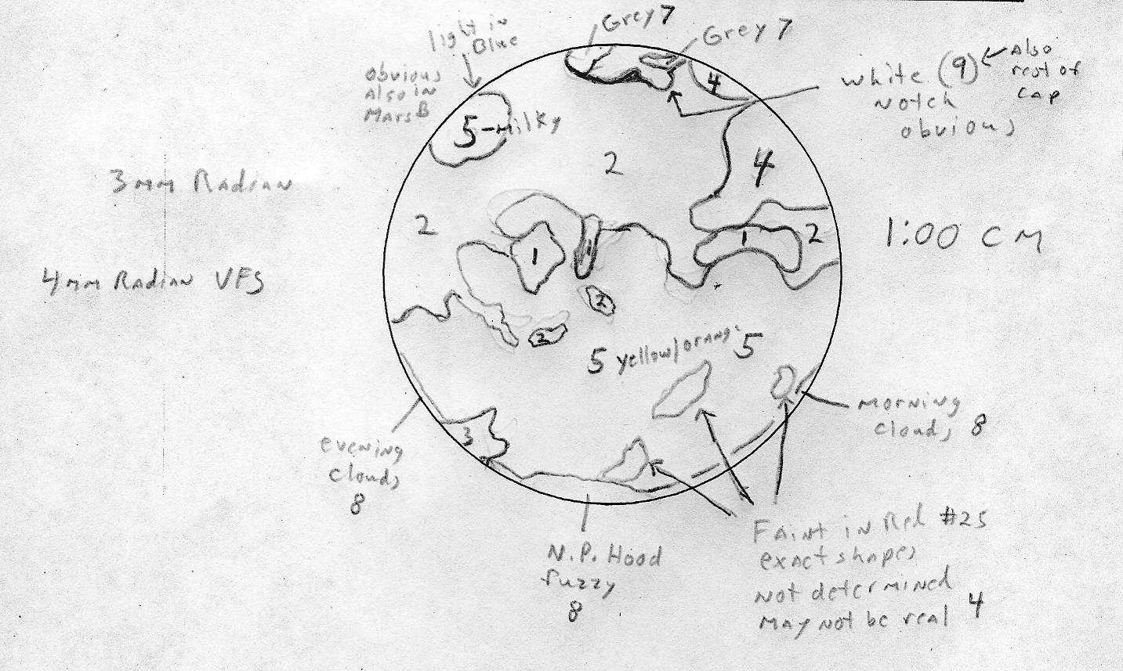
August 21, 2003 Size = 24.9”,
155mm Refractor 619x

Slide 21
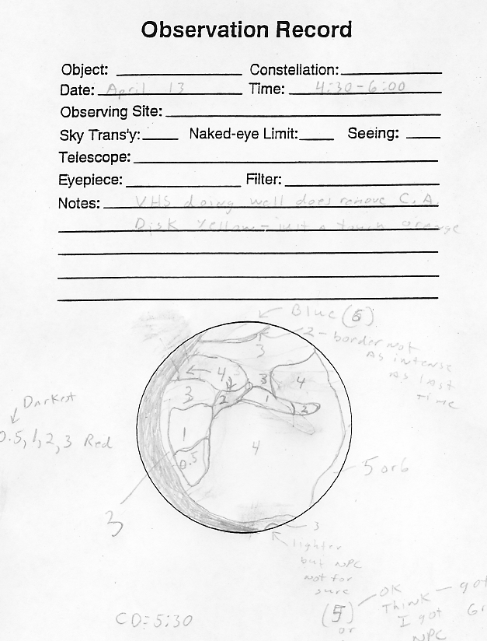
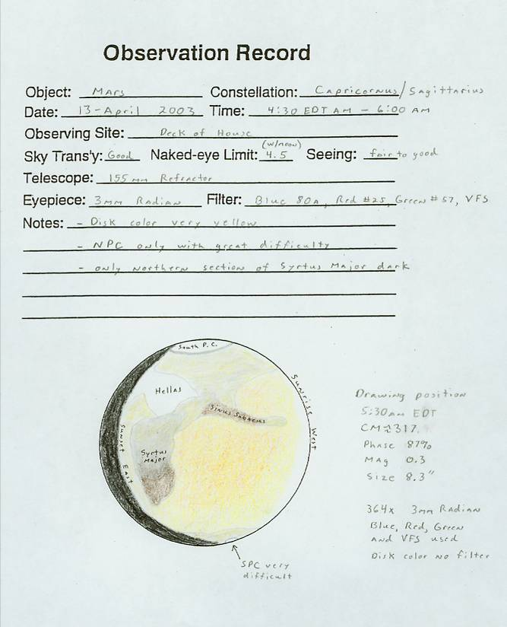

Slide 22
Additional Hints
Focus your telescope on the polar caps – not on the dark markings or the terminator
Draw only what you see not what you think should be there, remember surface features can be obscured by local or regional dust storms
Don’t try and make Mars red, determine its true color without using filters; most likely it will be more yellow than red through the telescope.

Slide 23
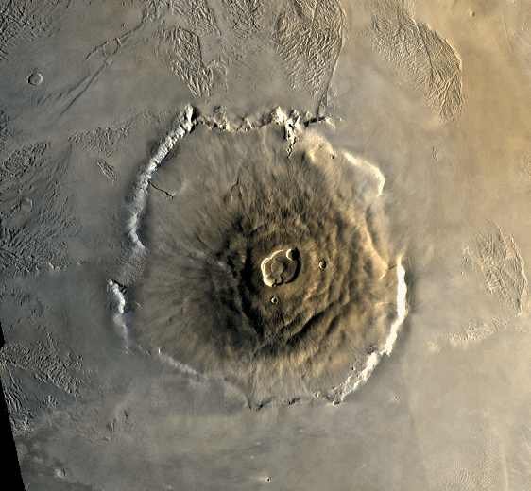
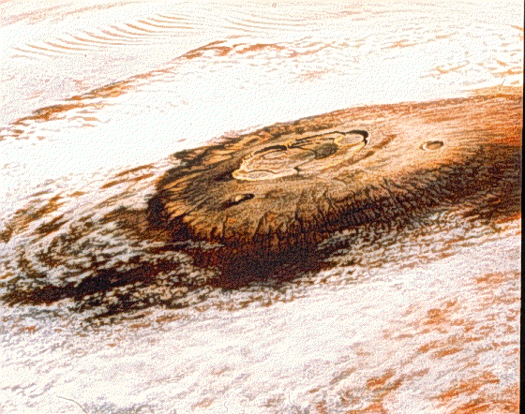
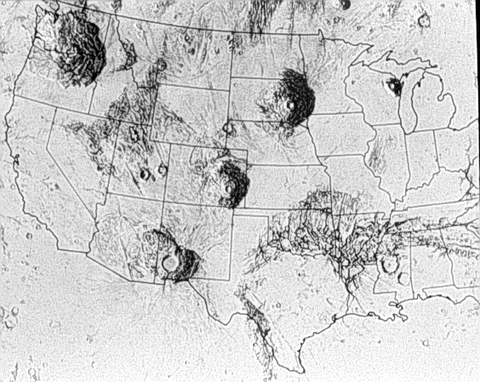
Prime Target 1 Nix Olympica – Olympus Mons
Four of the Tharsis Plateau volcanoes are truly giants, of which Olympus Mons is the biggest (420 miles across and 15 miles high).
Two reasons for size of the volcanoes 1) ridged crustal plate over a hot spot and 2) weaker gravity effects the lava buoyancy
Surrounded by a ½ mile rim of unknown origin (current thinking is that this rim is a sea cliff).
Named the Snows of Olympus before space visits because of the white clouds that form above the mountain – best seen a few hours before sunset on Mars.
With a 6% slope none of the volcanoes cast a shadow that can be seen in telescopes
Only chance of seeing the volcanoes proper are during a dust storm when contrast is great (appear as dark spots).

Slide 24
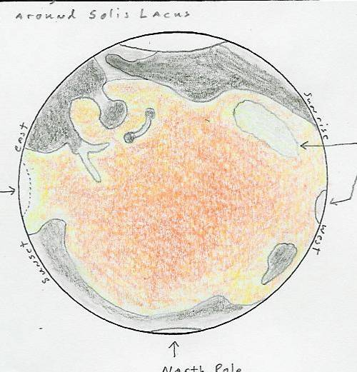
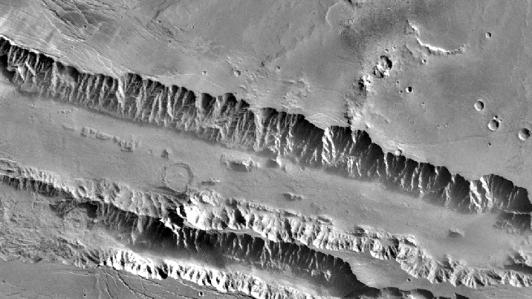
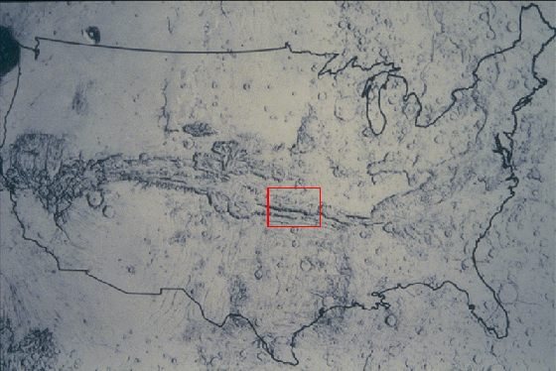
Prime Target 2 -- Valles Marineris Agathadaemon
1/6 circumference of Mars
3,000 miles long, 6 miles deep, up to 120 miles wide
Formed when the lifting of the Tharsis Plateau fractured the planet’s crust
Sculpted by wind, water and land slides
Canyon walls are layered throughout (origin?)
Faults along canyon’s sides are locations of the youngest volcanism on Mars (less than 1ml yr)
Notes:
Agathadaemon on the classical canal-filled maps of Schiaparelli (skya-pa-rel-lee) as a curving dark threadlike line. Agathadaemon is a minor mythological Greek deity of good fortune that had the form of a serpent. From what I can find out, back then pet snakes were believed to be reincarnations of the family’s ancestors and were considered lucky.

Slide 25
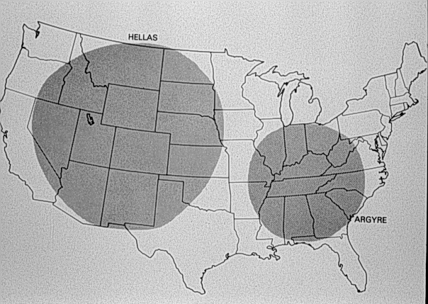
Prime Target 3
Impact Basins
Hellas (Greece) – 1,800 miles across and 5 miles deep
Argyre – 480 miles across
Both visible when frost covered
Observation hint – if the NPC is pointed toward you and you can also see Syrtis Major and the SPC looks big and bright you are likely mistaking Hellas for the South Pole Cap
Notes:
Argyre (AIR-jir)

Slide 26
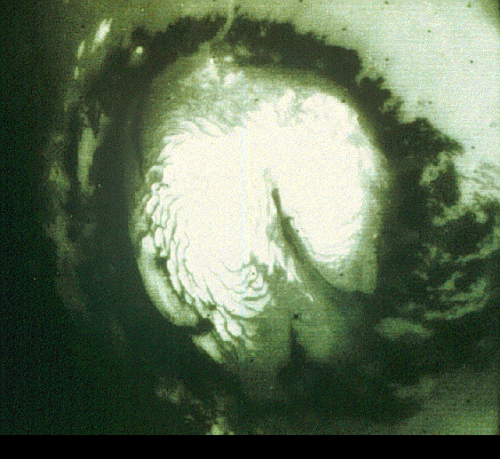
Prime Target 4 -- LOWELL BAND
As the NPC retreats it becomes surrounded by a dark blue collar expanding 19 miles a day towards the south
Once regarded as a melt water and later as expanding vegetation
In reality it is a large clay sand sea that covers an area the size of the Sahara with dunes about 3/10 of a mile apart
It appears to darken because of the greater distribution of light colored dust at this time of the year in the southern desert regions

Slide 27
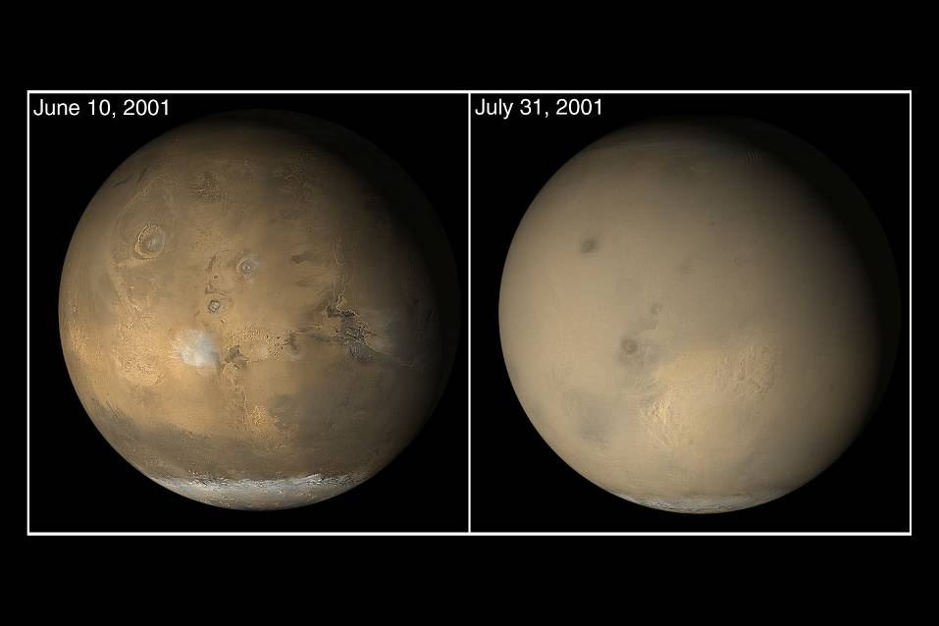
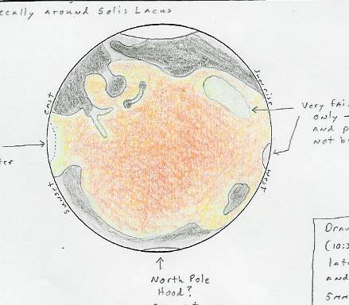
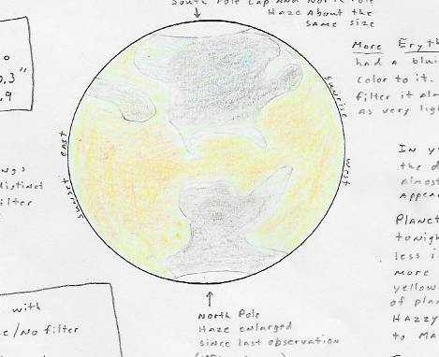
Prime Target 5
Local Dust Storms
Global level dust storms are most likely at perihelion but local dust storms are unpredictable and can occur even at aphelion and should be looked for especially from the middle of June 2012 to the end of the year.
25 – JUNE – 2001 O2 – JULY - 2001
Notes:
Look for black spots above the dust clouds – The great volcanoes!

Slide 28
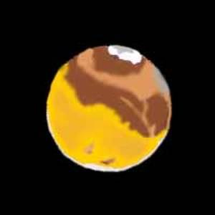
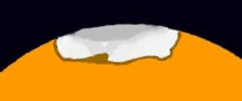
MARS DRAWING DATA CM = 2:00AM = 199 degrees Telescope = 155mm Refractor, Magnification = 464x & 619x Filters: Bandmate Mars Type 2 (augmented with Red #25, Green #58, Blue #80A) Size = 24.1", Phase = 98%, Magnitude = -2.6
MARS DRAWING OF SPC DATA CM = 3:00AM = 214 degrees Telescope = 155mm Refractor, Magnification = 619x Filters: Green #58 & Blue #80A Size = 24.1", Phase = 98%, Magnitude = -2.6
12 August 2003, 1:00 am to 3:00 am (Local Time)

Slide 29
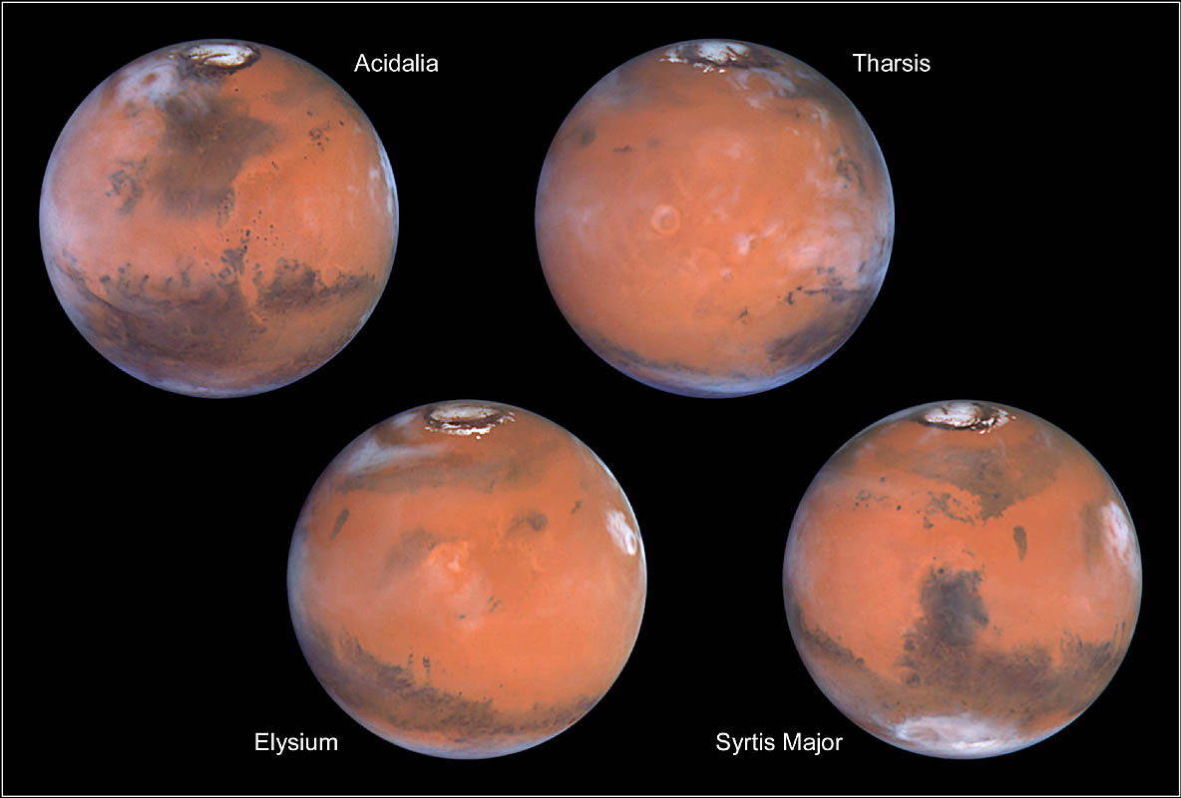
Mars as Hubble sees it
Once you look at Mars – You will never think of red light in the same way!

